Slide 1
Version 4
Version 3 fixes
Internationalization, Globalization & Localization
Update purchase offer
View system management
Load & Stress
Class diagram & system architecture

Slide 2

Internationalization Globalization Localization
As the global market continues to evolve and become interconnected, businesses are increasingly driven by the changing requirements and demands of international markets. This results in a continuously rising demand for Translation and Localization Services.
Often at the start of any Translation journey, businesses are faced with a choice of several types of approaches: Globalization, Internationalization, Localization, or Translation, but which one is most applicable to your specific situation and what is the Difference between them?

Slide 3
Globalization
Definition: The process by which businesses or other organizations develop international influence or start operating on a global scale.
It describes the ‘going global’ business practice of adapting content services and products to global, foreign markets from the standpoints of cultural, linguistic, and stylistic adaptation.

Slide 4
Internationalization
Definition: The design and development of a product, application or document content that enables easy Localization for target audiences that vary in culture, region, or language.
Internationalization implies the design and development of a content product or application in order to enable a streamlined localization and adaptation process for target audiences from linguistic, cultural and regional standpoints. The process entails, for example, adapting codes to specific local preferences (encodings, formats etc.), adapting user interface (UI) to be applicable in the case of multilingual translations and ensuring enough data buffer space, and so on.

Slide 5
Localization
Definition: The linguistic adaptation of content for the target region, its languages, and cultural particularities in order to make it appropriate, easily understandable, and comfortable to use for local native language speakers.
Localization requires in-depth knowledge of terminology and the specifics of the region and culture the localized content is intended for. Also, Localization requires modification of various aspects, such as the interface layout, numerical styles, local currencies, local time and date preferences, colors, units of measure, content, graphics and art style.

Slide 6
Connection to slr (service layer requirements)
Service layer requirements (also called non-functional requirements) describe how the system will be- how it will operate, how it will see etc. When localizing a system, more aspects of the system need to be thought of, and matching requirements should be created.
These requirements won’t be necessarily the same regarding to the place we’re operating in, because each place (region, country or even continent) has different culture. The language may be different, the currency, the formats of writing (date formats or even text direction), so when going global and localizing a system, we will need to make specific adaptation for each place and culture we want to approach.
Although globalization is not directly related to the implementation of a system, when we extend services to more places, new non-functional requirements need to be made for the system to operate correctly and appropriately in those places.

Slide 7
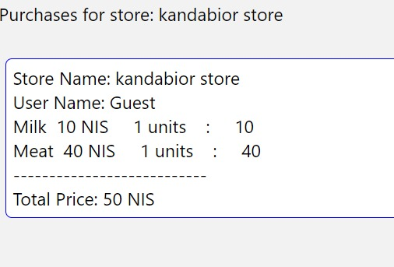
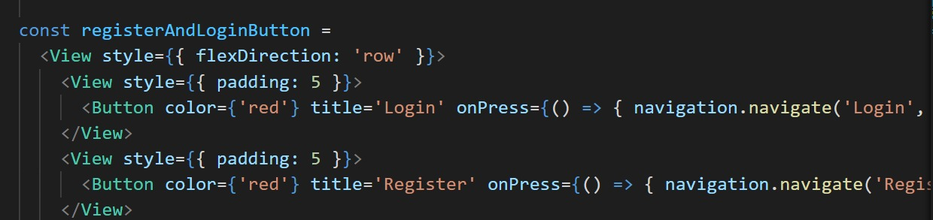
Support of these adaptations
Our trading system is intended to operate in Israel. Therefor, the currency used is NIS and the date format is dd/mm/yyyy- which are the conventions in this state. Also, we use the red color for buttons that hold main functionality, for example the buttons “Login” and “Register” in the system’s main page.
In other places we might have use different color, since there are cultures that may have negative feelings associated with the red color, when in Israel it means it is important and is used get the user’s attention.

Slide 8

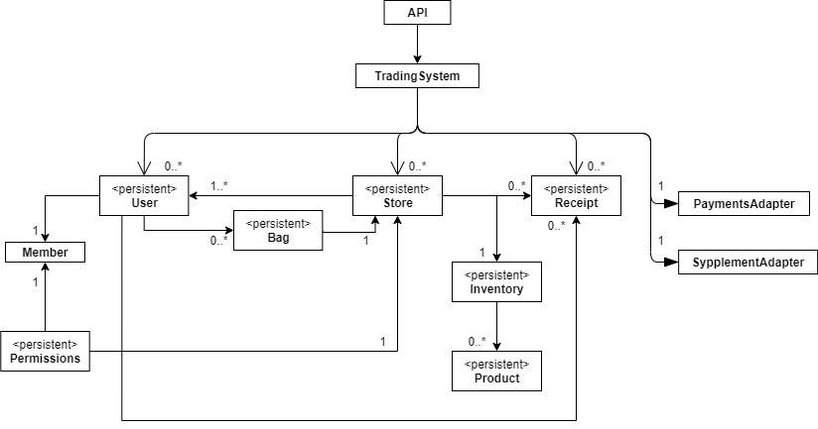
Class diagram

Slide 9
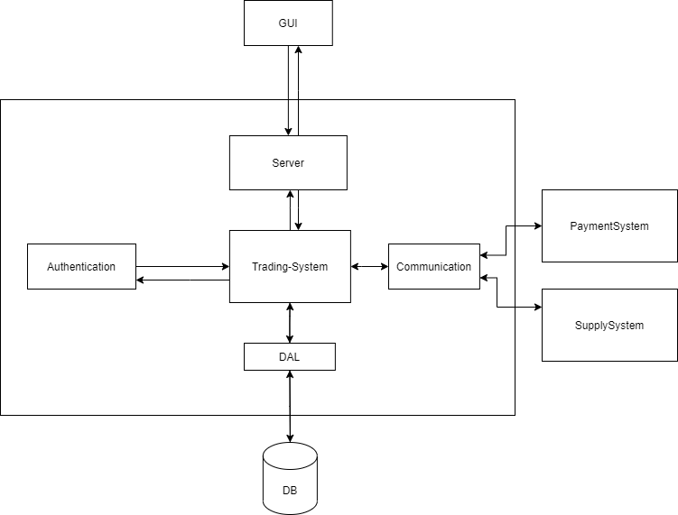
system architecture

